Slide 1

ZAS Robotic Products
Navigational Robotic Series
Robot Car-3 (Advanced Autonomy)
Encoder-Based Distance Measurement & Straight Motion

Slide 2
Encoder-Based Distance Measurement & Straight Motion
Objective
Move the robot exactly 1 meter
Use encoder feedback to measure distance
Maintain straight motion using tick comparison
Introduce encoders as position sensors
This program answers only one question:
“How far has the robot moved?”

Slide 3
Encoder-Based Distance Measurement & Straight Motion
Learning Outcomes
Encoder tick counting
Distance calculation from encoder
Straight motion correction
Encoders as position sensors
Foundation program — mandatory before advanced controll

Slide 4
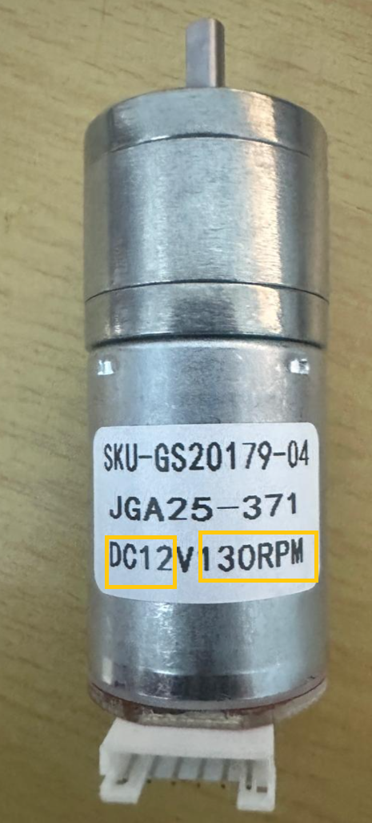
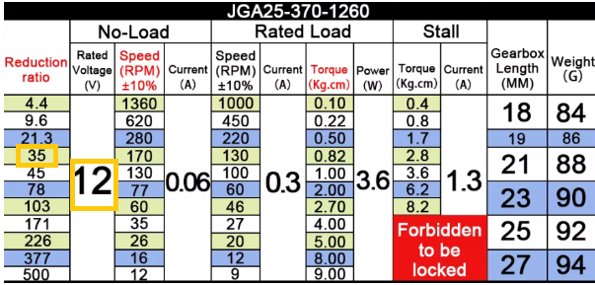
Encoder-Based Distance Measurement & Straight Motion
Encoder Basics
Incremental Encoder
Generates digital pulses (ticks) when motor shaft rotates
Output = ticks only
Tick
One pulse generated by the encoder
Encoder PPR (Pulses Per Revolution)
Number of ticks per motor shaft revolution
ENCODER_PPR = 11
Gear Ratio
Ratio between motor rotation and wheel rotation
GEAR_RATIO = 35;
Meaning:
Motor rotates 35 times → Wheel rotates once

Slide 5
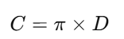
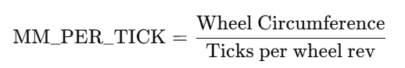

Encoder-Based Distance Measurement & Straight Motion
Distance Calculation (Core Formula)
Step-1: Wheel Circumference
Program : WHEEL_CIRC_MM = 3.1416 * WHEEL_DIAMETER_MM;
Step-2: Ticks per Wheel Revolution
TICKS_PER_WHEEL_REV = ENCODER_PPR * GEAR_RATIO;
Step-3: Distance per Tick
MM_PER_TICK = WHEEL_CIRC_MM / TICKS_PER_WHEEL_REV;
Distance Traveled
distanceMM = avgTicks * MM_PER_TICK;

Slide 6
Encoder-Based Distance Measurement & Straight Motion
Straight Motion Logic
Why Straight Correction is Needed
Left and right motors never rotate exactly the same
Small mismatch causes drift
Correction Formula
correction = (lTicks - rTicks) * kStraight;
pwmL = basePWM - correction;
pwmR = basePWM + correction;
This is NOT PI control This is simple proportional balancing

Slide 7
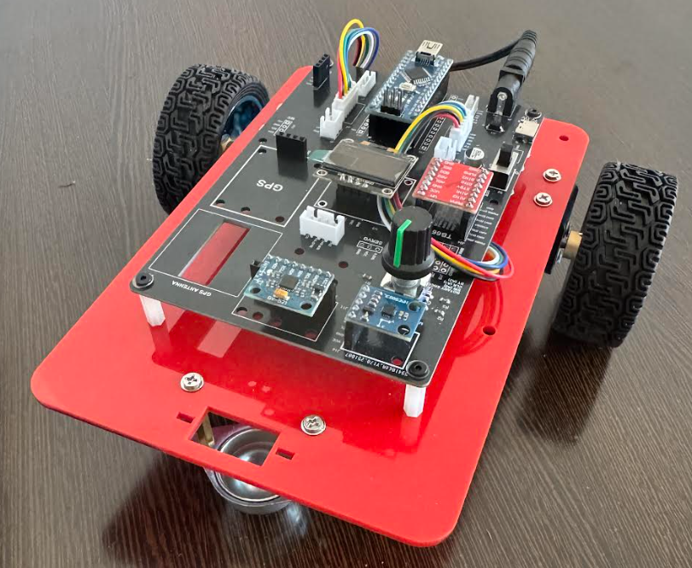
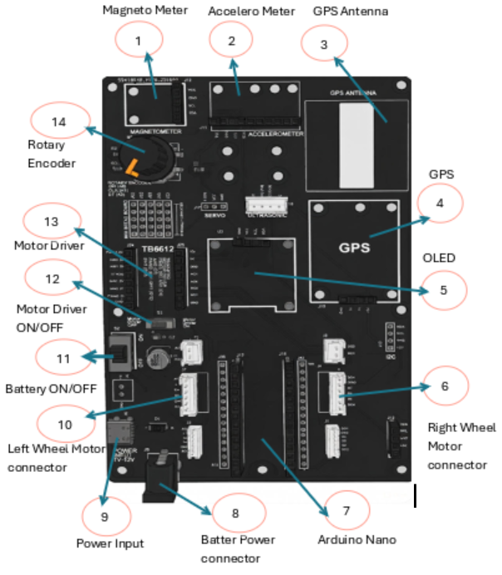
Encoder-Based Distance Measurement & Straight Motion
Robot Car-3 - Assembled view and Creative Board component layout

Slide 8
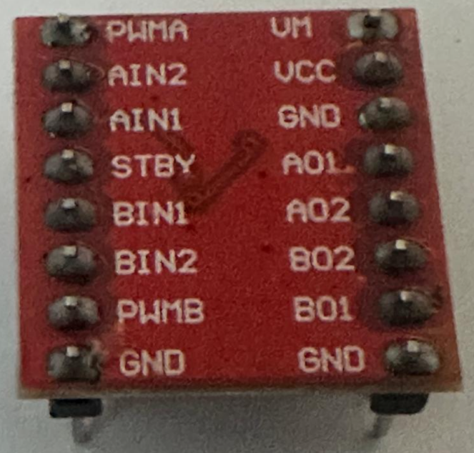
Encoder-Based Distance Measurement & Straight Motion
Hardware Architecture
Pin Name | Function | Description | Connected To (in Our Robot)
PWMA(PWM_L) | Speed Control (A) | PWM input for Motor A speed (0-255) | Arduino Pin 6
AIN1 (IN1_L) | Direction (A) Bit 1 | Motor A direction control | Arduino Pin 7
AIN2 (IN2_L) | Direction (A) Bit 2 | Motor A direction control | Arduino Pin 8
PWMB(PWM_R) | Speed Control (B) | PWM input for Motor B speed (0-255) | Arduino Pin 11
BIN1 (IN1_R) | Direction (B) Bit 1 | Motor B direction control | Arduino Pin 12
BIN2(IN2_R) | Direction (B) Bit 2 | Motor B direction control | Arduino Pin 10
STBY | Standby | Enable/Disable driver (HIGH = enabled) | Usually tied to VCC
VM | Motor Power | 7-12V for motors | External battery
VCC | Logic Power | 5V from Arduino | Arduino 5V
GND | Ground | Common ground | Arduino GND
AO1/AO2 | Motor A Outputs | Connect to Motor A terminals | Left Motor
BO1/BO2 | Motor B Outputs | Connect to Motor B terminals | Right Motor
TB6612 Pin configuration With Arduino

Slide 9
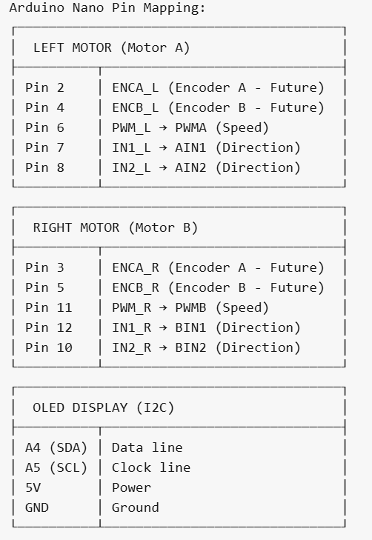
Encoder-Based Distance Measurement & Straight Motion
How H-Bridge Controls Motor Direction
Motor Control Truth Table
IN1 | IN2 | Motor Action
HIGH | LOW | ➡️ Forward
LOW | HIGH | ⬅️ Backward
LOW | LOW | 🛑 Stop (Coast)
HIGH | HIGH | 🔒 Brake
How It Works
IN1 = HIGH, IN2 = LOW: Switches S1 & S4 ON → Current flows one way → Motor spins Forward
IN1 = LOW, IN2 = HIGH: Switches S2 & S3 ON → Current flows opposite way → Motor spins Backward
Both LOW: No current → Motor coasts to stop
Both HIGH: Motor terminals shorted → Active brake

Slide 10
Encoder-Based Distance Measurement & Straight Motion
Algorithm (Step-by-Step) Car-3_distance_1Meter Algorithm
Reset encoder counts
Read left & right ticks
Compute average ticks
Convert ticks → distance
Apply straight correction
Compare with target distance
Stop when target reached

Slide 11
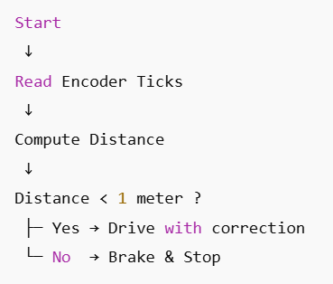
Encoder-Based Distance Measurement & Straight Motion
Flowchart (PPT Friendly)

Slide 12
Encoder-Based Distance Measurement & Straight Motion
Flowchart (PPT Friendly)

Slide 13

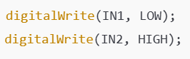
Encoder-Based Distance Measurement & Straight Motion
Code Highlights
Encoder Interrupts
Distance Check
Motor Control

Slide 14
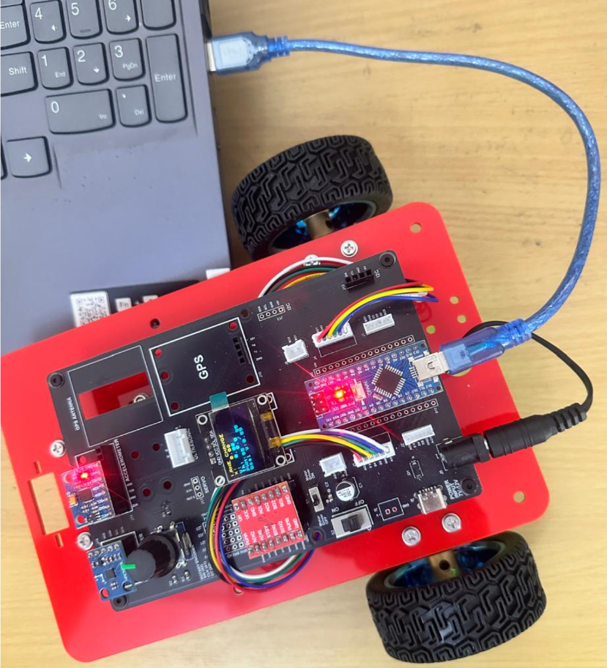
Encoder-Based Distance Measurement & Straight Motion
Critical Programming Setup
MANDATORY Switch Settings Before Uploading Code
Before connecting USB and uploading program:
“Motor Driver ON/OFF” Switch
⚠️ MUST BE SET TO: OFF
Why?
Prevents motors from running during code upload
Avoids car moving unexpectedly on desk
Protects USB connection from power surges

Slide 15
Encoder-Based Distance Measurement & Straight Motion
During Programming (Code Upload):
Step 1: Connect USB cable to computer
Step 2: Set Switch “Motor Driver ON/OFF” → OFF
Step 3: Set Switch “Battery ON/OFF ” → OFF ->for batter power
Step 4: Upload your the respective program
Step 5: Wait for "Upload Complete" message
Step 6: Disconnect USB cable
Before Testing (Running the Robot):
Step 1: Place robot on the ground. No obstacle as this test for basic movements
Step 2: Set Switch “Motor Driver ON/OFF” ->ON ( motor driver ON)
Step 3: Set Switch “Battery ON/OFF” → ON -> for batter power
Step 4: Monitor the Robot car-3 Movements & OLED , Monitior the functionality according to the program
https://github.com/info-zas/zas-robotics-car-3-encoders-imu-gps/tree/main/01_FoundationProjects/03_Car-3_Distance_1M
Lesson Code – GitHub URL:

Slide 16
Q&A
Invite Questions: Encourage the audience to ask questions for further clarification or discussion.

